Slide 1
6
Making Sense of Statistical Significance

Slide 2
Decision Errors -1
Describe the relation of the decision using the hypothesis testing procedure with results of a real study to the true (but unknown) real situation
Occur even if all computations are correct

Slide 3
Decision Errors
Situation in which the right procedure can lead to the wrong decisions

Slide 4
Decision Errors -2
Type I error
  Reject the null hypothesis when in fact it is true
  alpha (α)
    Probability of making a Type I error

Slide 5
Decision Errors -2
Type II error
  Do not reject the null hypothesis when in fact it is false
  beta (β)
    Probability of making a Type II error

Slide 6
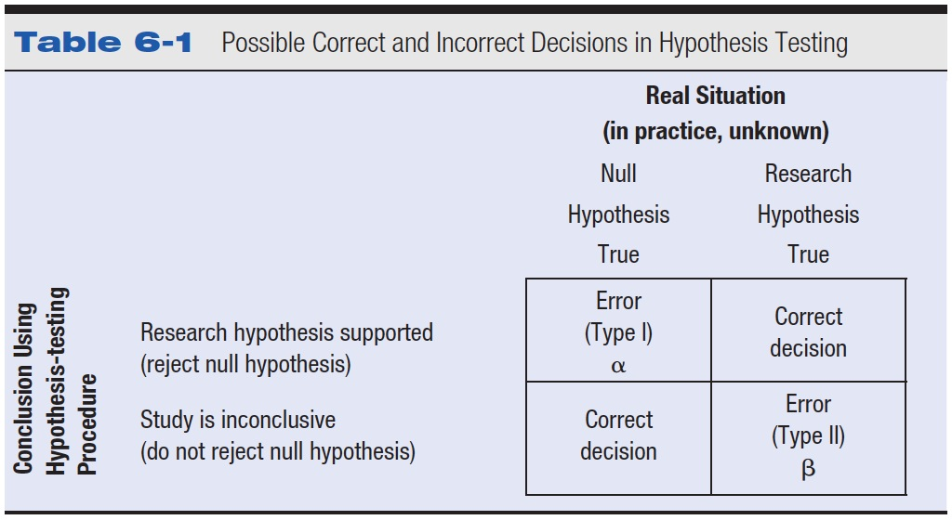
Table 6-1 Possible Correct and Incorrect Decisions in Hypothesis Testing

Slide 7
Decision Errors
Alpha and beta are inversely related
  Usually solved by standard p < .05
  But they are NOT opposites.
  (power and beta = opposites; alpha and correct rejection are opposites)

Slide 8
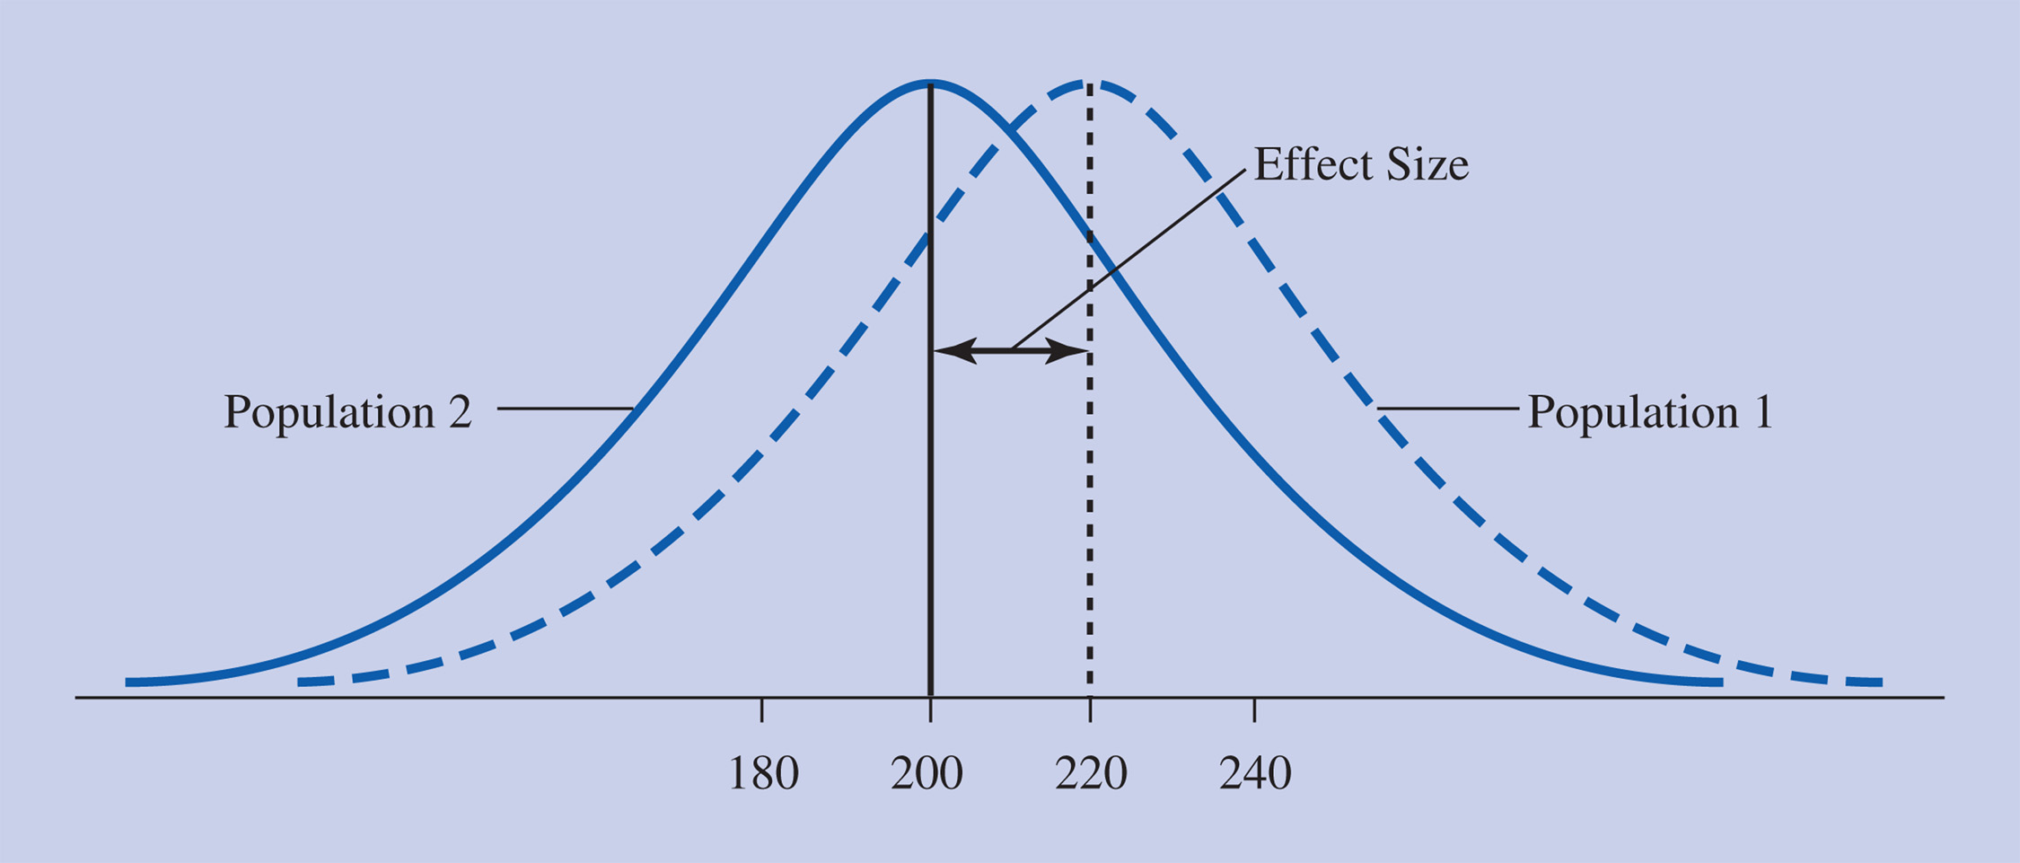
Effect Size -1
Amount that two populations do not overlap

Slide 9
Effect Size -2
The amount of overlap is influenced by predicted mean difference and population standard deviation
A standardized effect size adjusts the difference between means for the standard deviation

Slide 10

Formula for Effect Size
Figuring effect size (d)
  μ₁ = Mean of Population 1 (hypothesized mean for the population that is subjected to the experimental manipulation)

Slide 11
Formula for Effect Size
Figuring effect size (d)
  μ₂ = Mean of Population 2 (which is also the mean of the comparison distribution)
  σ = Standard deviation of Population 2 (assumed to be the standard deviation of both populations)

Slide 12
Example 1
Calculating effect size for personality / attractiveness
rating example from text
d = (μ₁ -μ₂)/σ
d = (208-200)/48
d = 8/48=.17

Slide 13
Example 2
What happens to the effect size when the mean difference is 16 and the population standard deviation is still 48?
d = (μ₁ -μ₂)/σ
d = 16/48=.33
The effect size is almost twice as large

Slide 14
Example 3
What happens to the effect size when the mean difference is 8 and the population standard deviation is 24?
d = (μ₁ -μ₂)/σ
d = 8/24=.33
The effect size is the same

Slide 15
Cohen’s Effect Size Conventions
  Small d = .2
  Medium d = .5
  Large d = .8

Slide 16
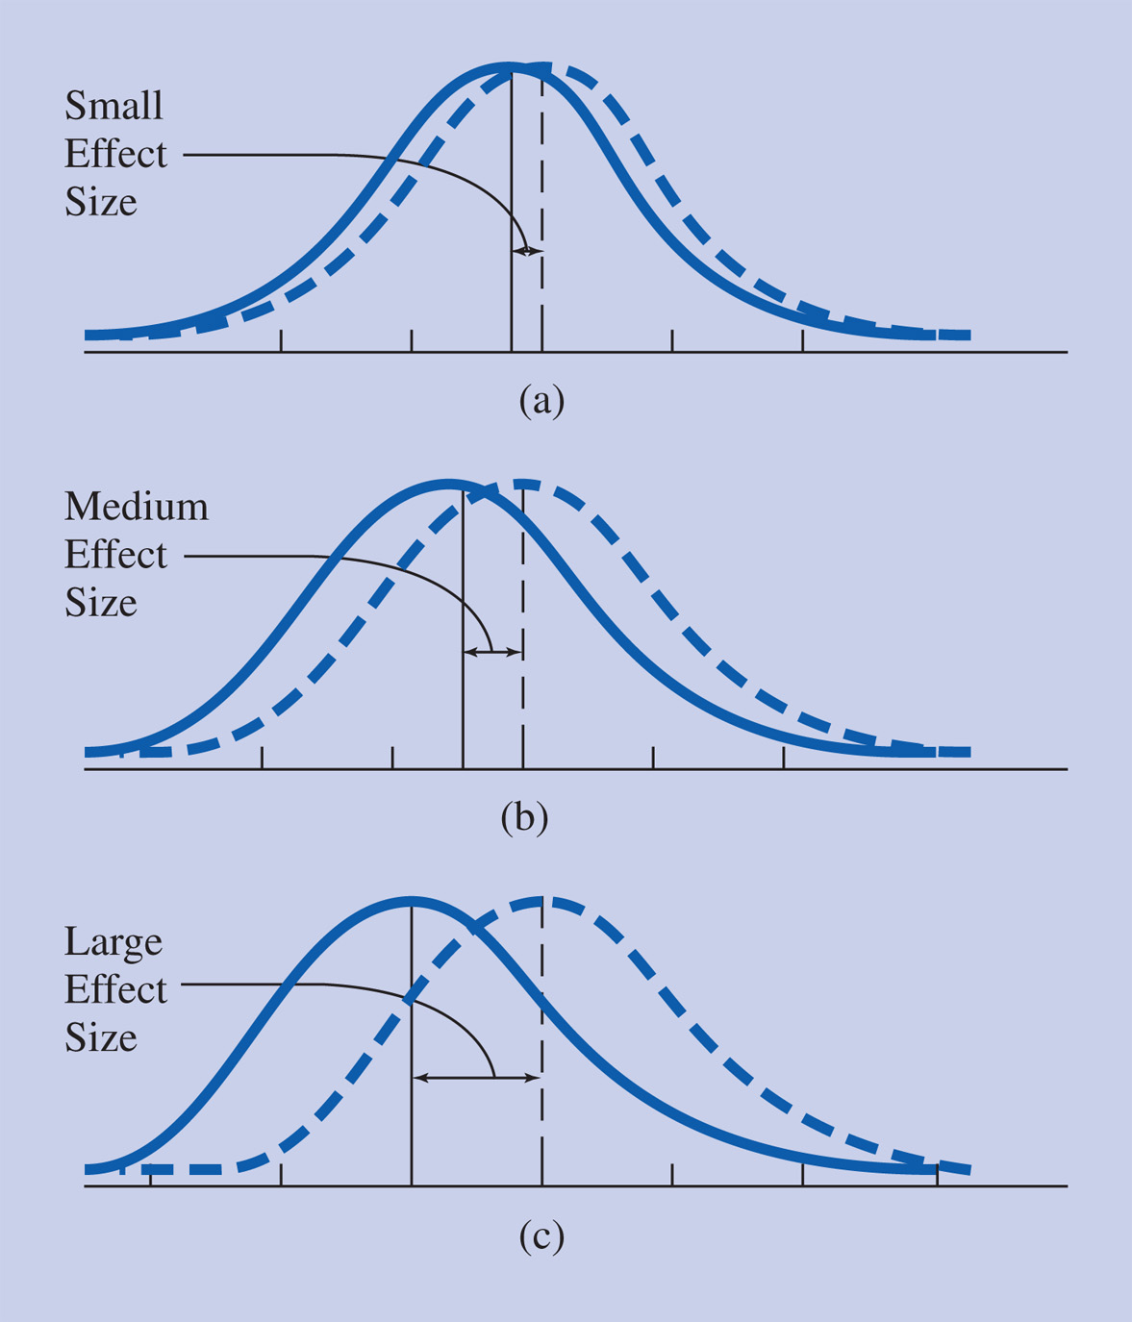
Figure 6-4 Comparisons of pairs of population distributions of individuals showing Cohen’s conventions for effect size: (a) small effect size (d = .20), (b) medium effect size (d = .50), (c) large effect size (d = .80).

Slide 17
Effect Size
Why use them?
  Compare across research studies
  People don’t use the same variables
  How “big” is the result?

Slide 18
Effect Size Assumptions
Assume the sample standard deviation is representative (in other words, the population it comes from has the same variance)
Assume the population standard deviation for the experimental group is the same that of the comparison distribution

Slide 19
Effect Sizes in Psychology
Usually small (.06 - .25)
.50 effect size is the desired effect size
In an experiment, measures the strength of your manipulation
In a comparison of groups, measures the raw difference between them
In a correlational study, measures the strength of association between 2 variables

Slide 20
Effect Size and Significance
In general, the larger the effect size the more likely a result is significant
However, a result can have a large effect size and not be significant
Similarly, a result can have a small effect size and be significant

Slide 21
Meta-Analysis
Combines results from different studies
Provides an overall effect size
Common in the more applied areas of psychology

Slide 22
Statistical Power
Probability that the study will produce a statistically significant result if the research hypothesis is true

Slide 23
Statistical Power
Steps for figuring power
1. Gather the needed information: mean and standard deviation of Population 2 and the predicted mean of Population 1
--- you need μ and σm
--- a predicted M
Copyright © 2009 Pearson Education, Inc. Upper Saddle River, NJ 07458. All rights reserved.

Slide 24
Statistical Power
2. Figure the raw score cutoff point on the population distribution (comparison distribution) to reject null hypothesis
  X = Zcutoff (σm) + μ
  Create a distribution – area past this score is α

Slide 25
Statistical Power
3. Figure the z-score for this same point, but now on the distribution of means.
    Z = (Cut off raw score – Sample predicted mean) / σm

Slide 26
Statistical Power
Steps for figuring power
4. Use the normal curve table to figure the probability of getting a score more extreme than that Z score
Copyright © 2009 Pearson Education, Inc. Upper Saddle River, NJ 07458. All rights reserved.

Slide 27

Influences on Power -1
Effect size
  Difference between population means
  Population standard deviation
  Figuring power from predicted effect sizes

Slide 28
Influences on Power -2
Sample size
  Affects the standard deviation of the distribution of means
Significance level (alpha)
One- versus two-tailed tests
Type of hypothesis-testing procedure

Slide 29
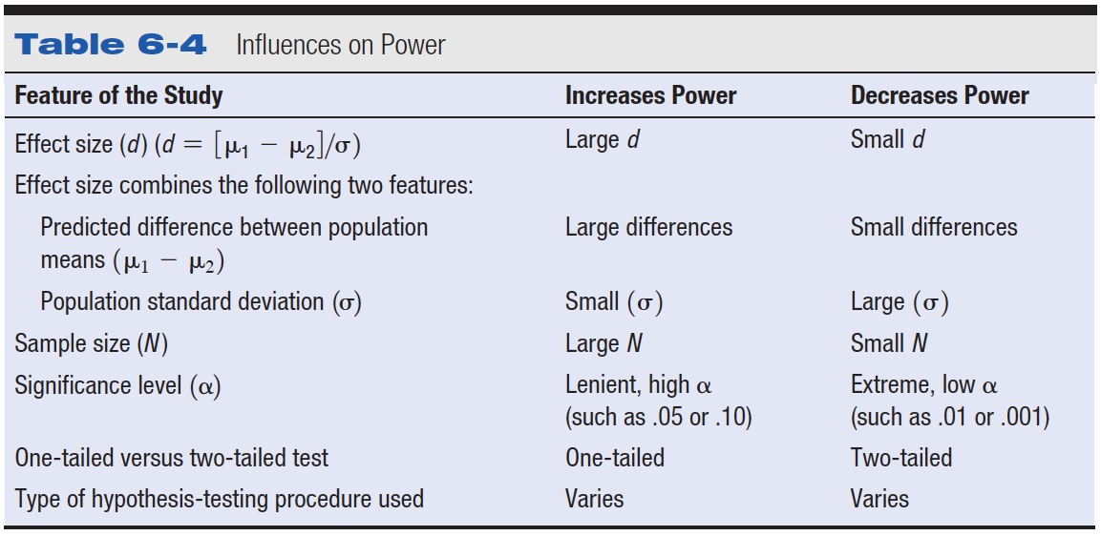
Table 6-4 Influences on Power

Slide 30
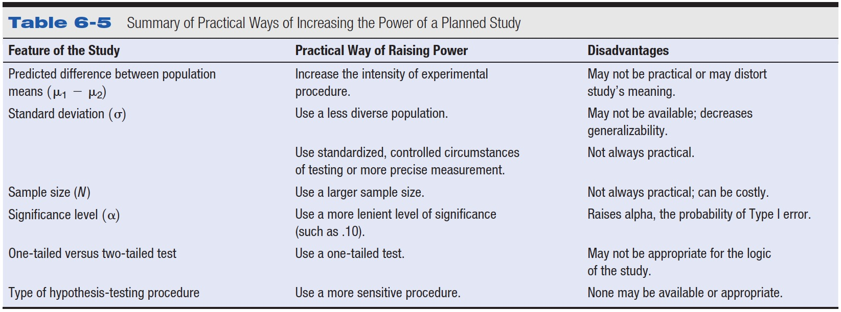
Table 6-5 Summary of Practical Ways of Increasing the Power of a Planned Study

Slide 31
Importance of Power When Evaluating Study Results
When a result is significant
  Statistical significance versus practical significance
When a result if not statistically significant

Slide 32
Controversies and Limitations
Effect size versus statistical significance
  Theoretically oriented psychologists emphasize significance
  Applied researchers emphasize effect size

Slide 33
Reporting in Research Articles
Increasingly common for effect sizes to be reported
Commonly reported in meta-analyses

Slide 34
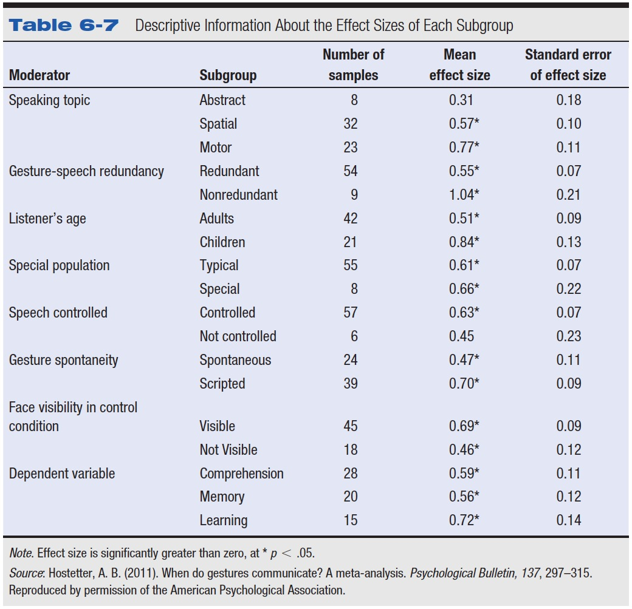
Table 6-7 Descriptive Information About the Effect Sizes of Each Subgroup

Slide 35
Examples
An organizational psychologist conducted a study to see whether upgrading a company's older computer system to newly released, faster machines would cause an increase in productivity from the current average of 120 units with a standard deviation of 20. The new system will be tested in a single department with 45 employees. The company has decided that an increase of less than 10 units will not justify purchasing the new system.
  What is the effect size?
  What is the power, p<.01?

Slide 36
Examples
A new company has made the claim that its test preparation program will improve SAT scores by 50 points. A skeptical educational psychologist has decided to test this theory, and has enlisted 20 students who are willing to participate in the program. Assume the standard SAT mean of 500 with a standard deviation of 100.
  What is the effect size?
  What is the power at p<.05?

